Slide 1
Distributed Systems Design COMP 6231
Communication
Lecture 4
Essam Mansour

Slide 2
Today…
Last Session:
Chapter 3
Today’s Session (Chapter 4.1):
Basic networking model
Layered Protocols

Slide 3

Classification of Communication Paradigms
Communication paradigms can be categorized into three types based on where the entities reside. If entities are running on:
1. Same Address-Space
Global variables, Procedure calls, …
Today, we will study how entities that reside on networked computers communicate in distributed systems using socket communication and remote invocation
2. Same Computer but Different Address-Spaces
Files, Signals, Shared Memory…
3. Networked Computers
Socket Communication
Remote Invocation

Slide 4
Networks in Distributed Systems
A distributed system is simply a collection of components that communicate to solve a problem
Why should designers of distributed systems know about networks?
Networking issues severely affect performance, fault-tolerance, and security of distributed systems
E.g., Gmail outage on Sep 1, 2010 – Google Spokesman said “we had slightly underestimated the load which some recent changes placed on the request routers. … . few of the request routers became overloaded… causing a few more of them to also become overloaded, and within minutes nearly all of the request routers were overloaded.”

Slide 5
A Primer: Latency and Bandwidth
Road 1
Road 2

Slide 6
A Primer: Latency and Bandwidth
Case 1
Case 2
B
B
L
L
Case 3
B
L
B = Bandwidth (or Capacity) and L = Latency (or Delay)
B × L gives approximately the number of bits in flight
As B × L increases, uncertainty increases (more bits might get lost)
High value of B × L leads to “Buffer Bloat”

Slide 7
Networks in Distributed Systems
Networking Issue | Comments on a Distributed System Design
Performance
Scalability
Reliability
Security
Mobility
Quality-of-service
Affects choices of whether to optimize for network or other resources
Size of Internet is increasing; expect greater traffic and latency in future
Detect communication errors and perform error-checks at the application layer (end-to-end argument!)
Install firewalls at gateways; deploy end-to-end authentication; employ encryption, etc.,
Expect intermittent connection for mobile devices
Internet is best-effort. It is hard to ensure strict QoS guarantees for, say, multimedia data

Slide 8
Network Classification
Important ways to classify networks
Based on size
Local Area Networks (LAN)
Wide Area Networks (WAN)
Based on technology
Ethernet Networks
Wireless Networks
Cellular Networks

Slide 9


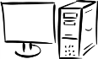
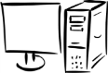
Brief Summary of Important Networks
(Based on Size)
A Segment
A Point-to-point link
Local Area Network (LAN)
A network of networks
A Network
Wide Area Network (WAN)
Notes:
9

Slide 10
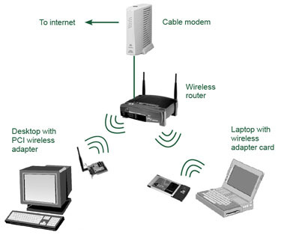
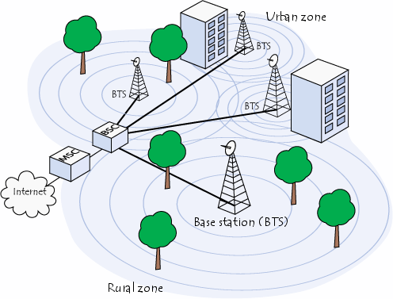
Types of Networks – Based on Technology
Ethernet Networks
Predominantly used in the wired Internet
Wireless LANs
Primarily designed to provide wireless access to the Internet
Low-range (100s of m), high-bandwidth
Cellular networks (2G/3G/4G)
Initially, designed to carry voice
Large range (few kms)
Low-bandwidth

Slide 11
Typical Performance for Different Types of Networks
Network | Example | Range | Bandwidth (Mbps) | Latency (ms)
Wired LAN | Ethernet | 1-2 km | 10 – 10,000 | 1 – 10
Wired WAN | Internet | Worldwide | 0.5 – 600 | 100 – 500
Wireless PAN | Bluetooth | 10 – 30 m | 0.5 – 2 | 5 – 20
Wireless LAN | WiFi | 0.15 – 1.5 km | 11 – 108 | 5 – 20
Cellular | 2G – GSM | 100m – 20 km | 0.270 – 1.5 | 5
Modern Cellular | 3G | 1 – 5 km | 348 – 14.4 | 100 – 500

Slide 12
Networking Principles
Network Protocols
Packet Transmission
Network Layers
Physical layer
Data-link layer
Network layer and routing
Transport layer and congestion control

Slide 13
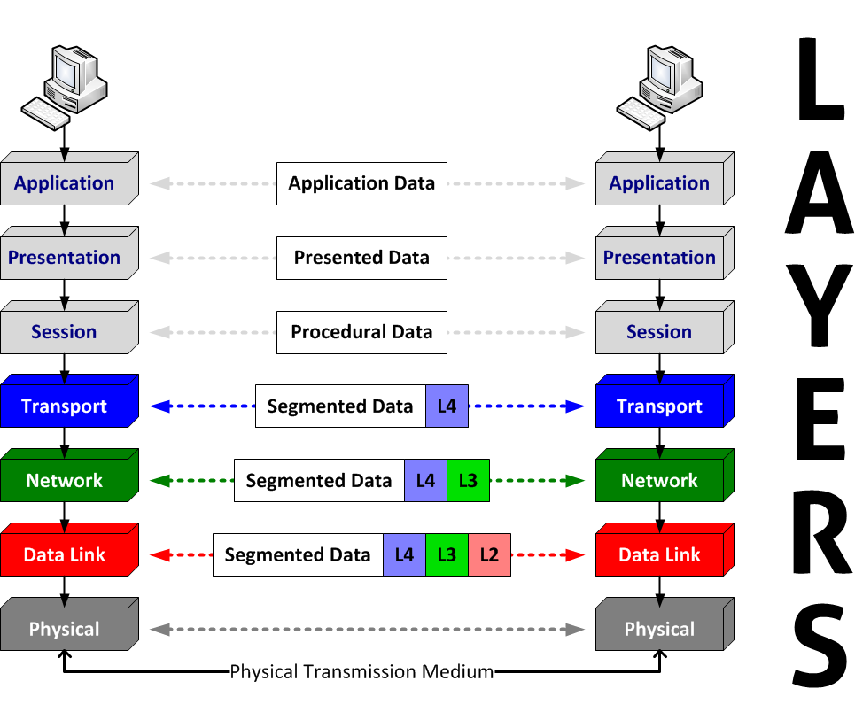
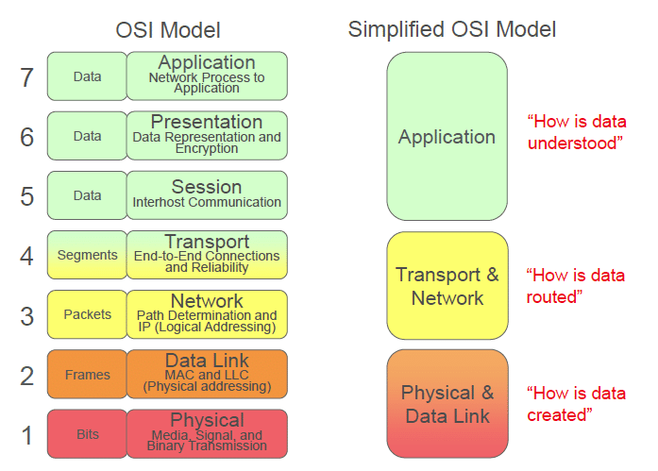
Layered Protocols

Slide 14
Networking Protocols
If two entities want to communicate on a network, pre-defined agreements are necessary
How a message will be formatted?
How does the receiver know the last bit in the message?
How can a receiver detect if the message is damaged?
“Protocol” is a well-known set of rules and formats to be used for communication between the entities
Standardizing a well-known set of protocols supports communication among heterogeneous entities
Notes:
Networks allow an entity on one machine to communicate with another entity on another machine

Slide 15
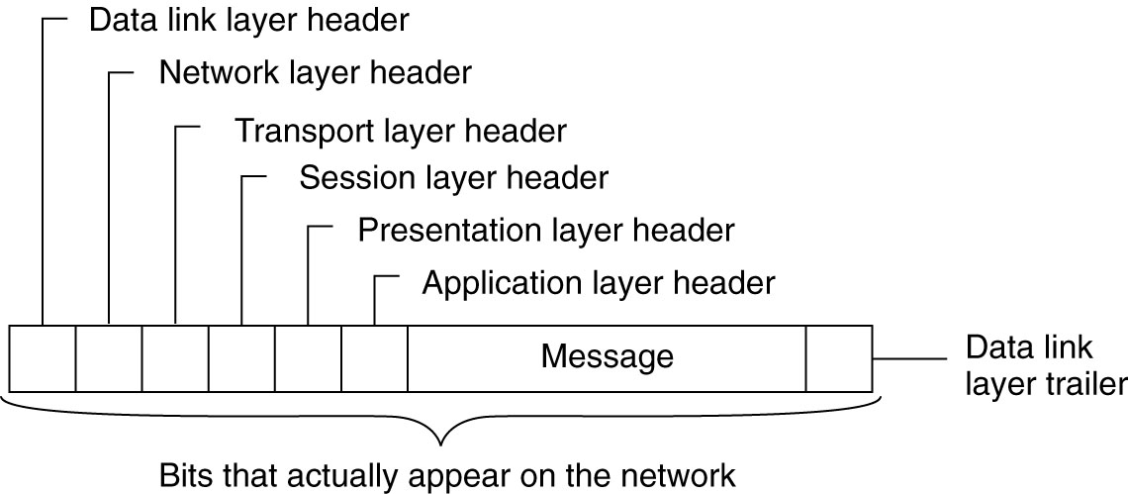
Networking Principles
A typical message as it appears on the network.

Slide 16
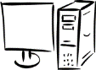
Packet Transmission
Messages are broken up into packets
A packet is the unit of data that is transmitted between an origin and a destination
Packets can be of arbitrary lengths
Maximum size of the packet is known as Maximum Transmission Unit (MTU)
MTU prevents one host from sending a very long message
Each packet has two main fields
Header: Contains meta-information about the packet
e.g., Length of the packet, receiver ID
Data
Header
Data

Slide 17
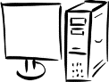


Network Layers
Network software is arranged into a hierarchy of layers
Protocols in one layer perform one specific functionality
Layering is a scalable and modular design for complex software
Typical functionalities in a network software:
011100011 0011 011
Src
Functionality | Layer
contains the specification and implementation of bits, and their transmission between sender and receiver
prescribes the transmission of a series of bits into a frame to allow for error and flow control
describes how packets in a network of computers are to be routed.
provides the actual communication facilities for most distributed systems.
Satisfies communication requirements for specific applications
Physical
Dest
Data link
Destination machine
Network
P1
P2
P3
Transport
Application

Slide 18
Physical Layer
Physical layer protocols transmit a sequence of bits over a transmission medium
Modulate the bits into signals that can be transmitted over the medium
Transmission Medium | Type of signal transmitted
Twisted-pair (Ethernet cable) | Electrical signal
Fiber Optic Circuits | Light signal
Wireless channel | Electro-magnetic signal
Data-link layer protocol
Bits
A physical layer protocol
Signal
Transmission Medium

Slide 19
Data-link Layer
Protocols in data-link layer ensure that the packets are delivered from one host to another within a local network
Data-link layer protocols provide two main functionalities:
How to coordinate between the transmitters such that packets are successfully received?
Coordination
How to identify another host on the local network?
Addressing over local networks

Slide 20


Addressing over Local Networks
Each device that is connected to a network has a unique address called Medium Access Control (MAC) address
MAC addresses are six bytes long
e.g., 2A:D4:AB:FD:EF:8D
Approach:
Data-link layer broadcasts the packet over the medium
Receiver reads the packet header and checks if the packet is addressed to it
x
x

Slide 21

Network Layer
Network layer protocols perform the role of routing
They ensure that a packet is routed from the source machine to the destination machine
Packets may traverse different LANs to reach the destination
Internet Protocol (IP) is a widely-used network layer protocol
IP addresses are typically used to identify machines
Router
Source
Destination

Slide 22
Router
A router is a device that forwards the packets between multiple networks
Routers are connected to two or more networks
Each network interface is connected to a LAN or a host
Packet travels up until the network layer on the router
Source machine
Router
Dest machine
A Router
Application
Application
LAN-1
LAN-3
Transport
Transport
Int-1
Int-2
Int-3
Network
Network
Network
Data-link
Data-link
Data-link
LAN-2
Physical
Physical
Physical

Slide 23
Transport Layer
The transport layer provides the actual communication facilities for most distributed systems.
Destination machine
P1
P2
P3
Transport layer protocol
Network layer protocol
Standard Internet protocols
TCP: connection-oriented, reliable, stream-oriented communication
UDP: unreliable (best-effort) datagram communication

Slide 24
UDP Sockets
User Datagram Protocol (UDP) provides connectionless communication, with no acknowledgements or message retransmissions
Communication mechanism:
Server opens a UDP socket SS at a known port sp,
Socket SS waits to receive a request
Client opens a UDP socket CS at a random port cx
Client socket CS sends a message to ServerIP and port sp
Server socket SS may send back data to CS
Client
SS.receive(recvPacket)
Server
No ACK will be sent by the receiver
CS
CS.Send(msg, ServerIP, sp)
SS
cx
sp
SS.Send(msg, recvPacket.IP, recvPacket.port)
H
= Host computer H
S
= Socket S
n
= Port n

Slide 25
UDP– Design Considerations
Sender must explicitly fragment a long message into smaller chunks before transmission
A maximum size of 548 bytes is suggested for transmission
Messages may be delivered out-of-order
If necessary, programmer must re-order packets
Communication is not reliable
Messages might be dropped due to check-sum errors or buffer overflows at routers
Receiver should allocate a buffer that is big enough to fit the sender’s message
Otherwise the message will be truncated

Slide 26
TCP Sockets
Transmission Control Protocol (TCP) provides in-order delivery, reliability, and congestion control
Communication mechanism:
Server opens a TCP server socket SS at a known port sp
Server waits to receive a request (using accept call)
Client opens a TCP socket CS at a random port cx
CS initiates a connection initiation message to ServerIP and port sp
Server socket SS allocates a new socket NSS on random port nsp for the client
CS can send data to NSS
Client
nSS = SS.accept()
Server
Shall I send?
SS
CS
OK. Set your transmission port to nsp
sp
cx
CS.Send(msg)
nSS
TCP fragments the message & transmits data; receiver ACKs receptions
nsp

Slide 27
Main Advantages of TCP
TCP ensures in-order delivery of messages
Applications can send messages of any size
TCP ensures reliable communication via using acknowledgements and retransmissions
Congestion control of TCP regulates sender rate, and thus prevents network overload

Slide 28
TCP vs UDP

Slide 29
TCP vs UDP
TRANSMISSION CONTROL PROTOCOL (TCP) | USER DATAGRAM PROTOCOL (UDP)
a connection-oriented protocol. Connection-orientation means that the communicating devices should establish a connection before transmitting data and should close the connection after transmitting the data. | a datagram oriented protocol. This is because there is no overhead for opening a connection, maintaining a connection, and terminating a connection. UDP is efficient for broadcast and multicast type of network transmission.
TCP is reliable as it guarantees delivery of data to the destination router. | The delivery of data to the destination cannot be guaranteed in UDP.
TCP provides extensive error checking mechanisms. It is because it provides flow control and acknowledgment of data. | UDP has only the basic error checking mechanism using checksums.
Sequencing of data is a feature of Transmission Control Protocol (TCP). this means that packets arrive in-order at the receiver. | There is no sequencing of data in UDP. If ordering is required, it has to be managed by the application layer.
TCP is comparatively slower than UDP. | UDP is faster, simpler and more efficient than TCP.
Retransmission of lost packets is possible in TCP, but not in UDP. | There is no retransmission of lost packets in User Datagram Protocol (UDP).
TCP has a (20-80) bytes variable length header. | UDP has a 8 bytes fixed length header.
TCP is heavy-weight. | UDP is lightweight.
TCP doesn’t supports Broadcasting. | UDP supports Broadcasting.
TCP is used by HTTP, HTTPs, FTP, SMTP and Telnet. | UDP is used by DNS, DHCP, TFTP, SNMP, RIP, and VoIP.

Slide 30
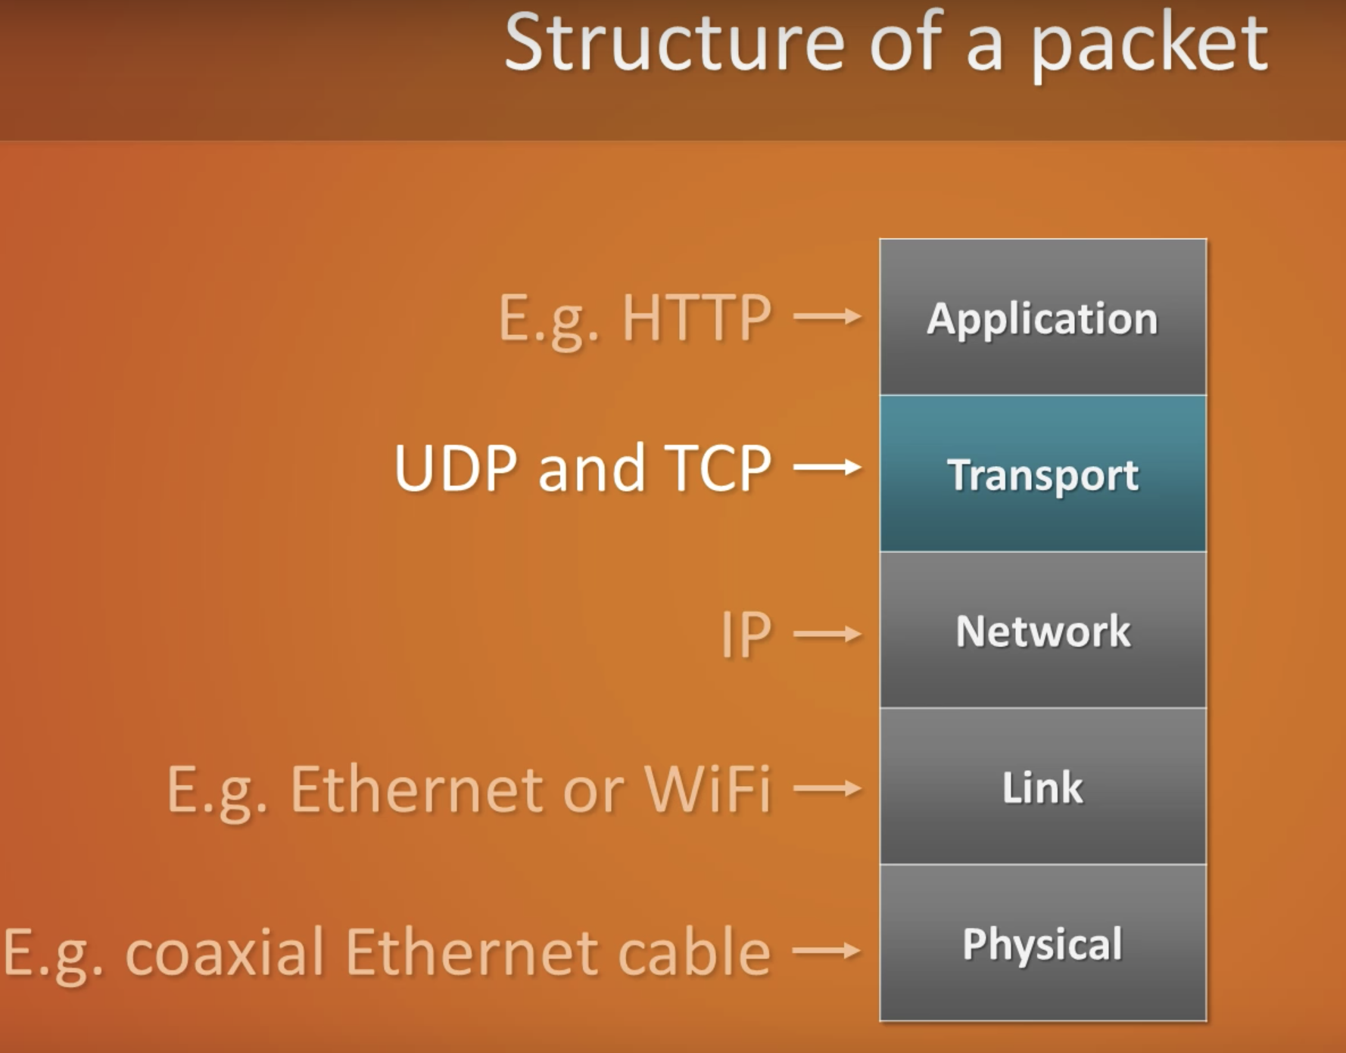
Layered Protocols with Examples

Slide 31
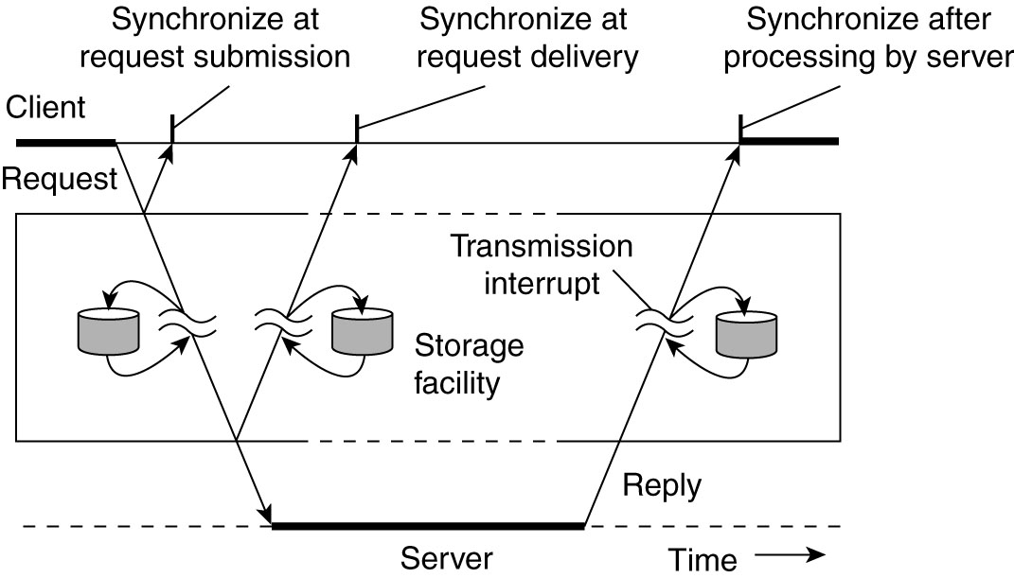
Types of communication
Transient communication: Comm. server discards message when it cannot be delivered at the next server, or at the receiver. Persistent communication: A message is stored at a communication server as long as it takes to deliver it.
Places for synchronization
At request submission
At request delivery
After request processing
Viewing middleware as an intermediate (distributed) service in application-level communication.
Notes:
- In practice, the focus is on masking crash and omission failures
Add a slide prior to this slide with an animated example to make your point clear.

Slide 32
Transient communication
Some observations
Client/Server computing is generally based on a model of transient synchronous communication:
Client and server have to be active at time of communication
Client issues request and blocks until it receives reply
Server essentially waits only for incoming requests, and subsequently processes them
Drawbacks synchronous communication
Client cannot do any other work while waiting for reply
Failures have to be handled immediately: the client is waiting
The model may simply not be appropriate (mail, news)
Notes:
- In practice, the focus is on masking crash and omission failures
Add a slide prior to this slide with an animated example to make your point clear.

Slide 33
Persistent communication
Message-oriented middleware
Aims at high-level persistent asynchronous communication:
Processes send each other messages, which are queued
Sender need not to wait for immediate reply, but can do other things
Middleware often ensures fault tolerance
Notes:
- In practice, the focus is on masking crash and omission failures
Add a slide prior to this slide with an animated example to make your point clear.

Slide 34
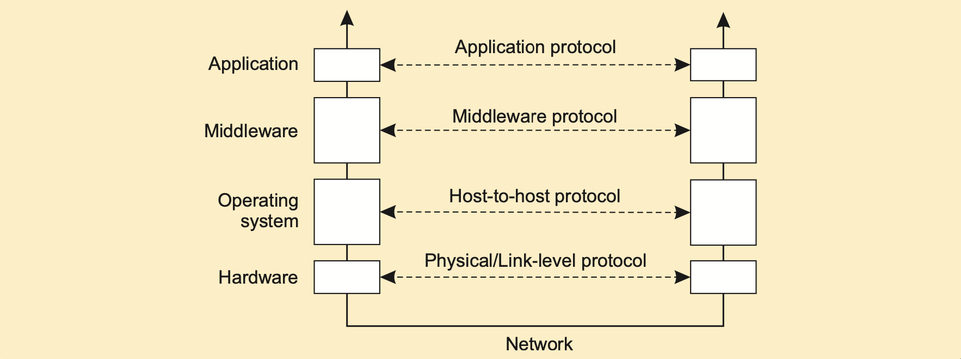
An adapted layering scheme
Notes:
- In practice, the focus is on masking crash and omission failures
Add a slide prior to this slide with an animated example to make your point clear.

Slide 35
Middleware Layers
Observation
Middleware is invented to provide common services and protocols that can be used by many different applications:
A rich set of communication protocols
(Un)marshaling of data, necessary for integrated systems
Naming protocols, to allow easy sharing of resources
Security protocols for secure communication
Scaling mechanisms, such as for replication and caching
Notes:
- In practice, the focus is on masking crash and omission failures
Add a slide prior to this slide with an animated example to make your point clear.

Slide 36
Middleware Layers
Applications, Services
Remote Invocation
Middleware Layers
IPC Primitives (e.g., Sockets)
Transport Layer (TCP/UDP)
Network Layer (IP)
Data-Link Layer
Physical Layer
Notes:
- In practice, the focus is on masking crash and omission failures
Add a slide prior to this slide with an animated example to make your point clear.

Slide 37
A To-Do List
Read Chapters 4.1
Prepare for the mid-term exam on Oct 18

